Slide 1

In the name of Allah (God), the most beneficent
and most merciful
1
Notes:
1

Slide 2
Final Presentation
DATABOT
Group Members
Muhammad Sanan (Cu-481-2018)
Mustafa Haider (Cu-470-2018)
Hamza Ayaz (Cu-524-2018)
Project Supervisor
Ma’am Zainab Jamil

Slide 3
CONTENTS
Introduction
Literature Review (Other Similar Systems)
Suggestion
Design (Screens/Code)
Testing
Deployment.
Future extensions
References
3
Notes:
3

Slide 4



INTRODUCTION
Just look the most valuable companies in the world. In 2006 these were the oil and energy companies. In 2012 the list included Google, Amazon and Facebook.
The world’s most valuable resource is no longer oil, but data.
To design and develop such application that extract products data from different e-commerce stores and show all the products in one place so the user can buy products within their range.
4
Notes:
4

Slide 5



LITERATURE REVIEW
“ FARFETCH” is a British-Portuguese online luxury fashion retail platform that sells products from over 700 boutiques and brands.
“ZASIMO” Pakistan’s largest online destination for the latest and best western high street and international fashion, footwear and accessory brands.
“ LYST ” Shop and discover the world's most stylish brands, curated for you. With more than 1000 brands and stores in one place.

Slide 6
LITERATURE REVIEW
Applications | Targeted Brands | Platforms
FARFETCH [1] | Alexander McQueen, Balenciaga, Bottega Veneta, Gucci, Givenchy, Prada, Saint Laurent, Versace | Web Application
ZASIMO [2] | New Look, Burton, Jack&Jones, Quizman, Bravl Soul, Only, Blend | Web Application
LYST [3] | Nike, Gucci, Moncler, Barbour, Diesel, The north face, Kenzo, Balmain | Web Application
DATABOT | J., Almirah, Heels, Leisure Club, Metro, Ndure, Shoeplant, urbansole, Servis, Edenrobe, Bareeze, Breakout, Sanasafinaz, Outfitters,Alkaram etc…. | Web, Android

Slide 7
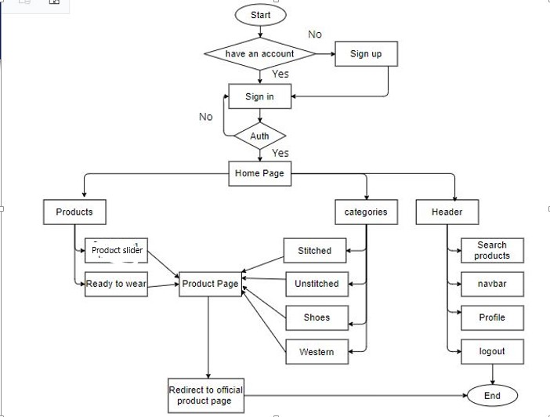
DETAILED FLOW CHART

Slide 8
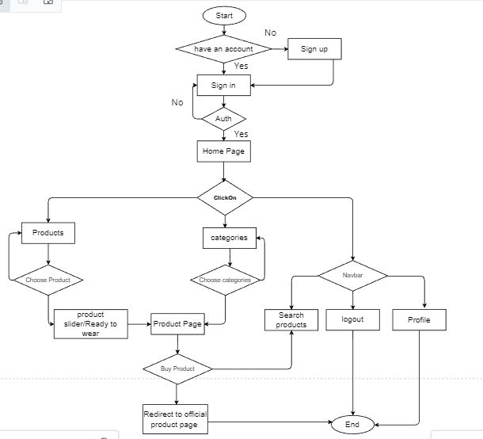
DETAILED FLOW CHART( Suggestion )

Slide 9
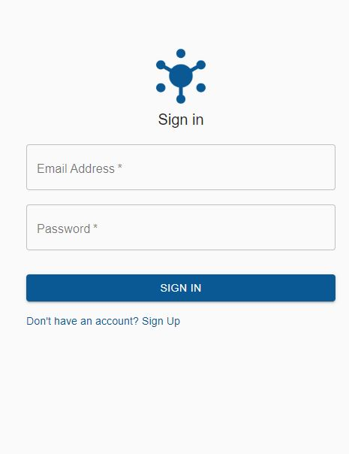
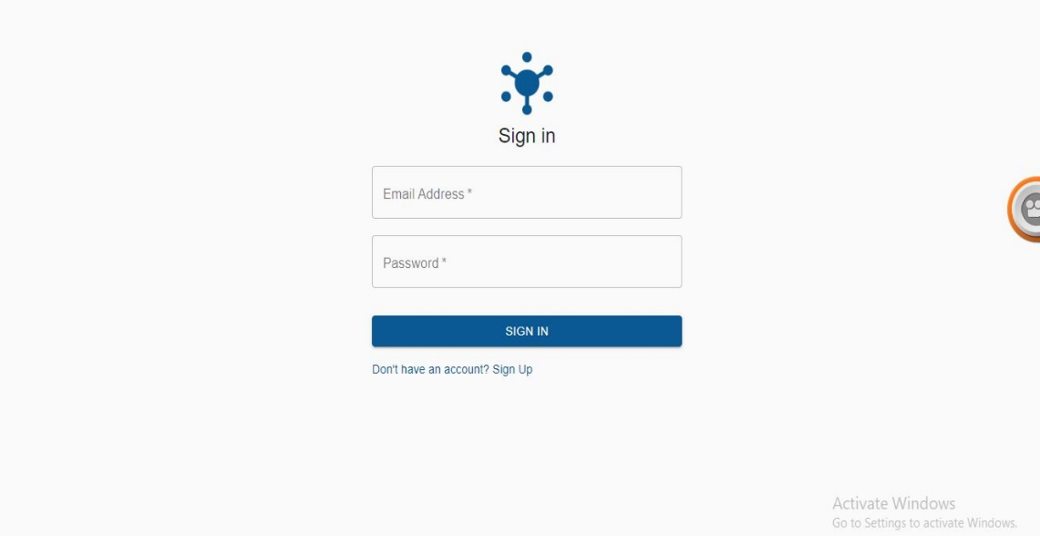
DESIGN (screens)
Mobile app
Web app
9
Notes:
9

Slide 10
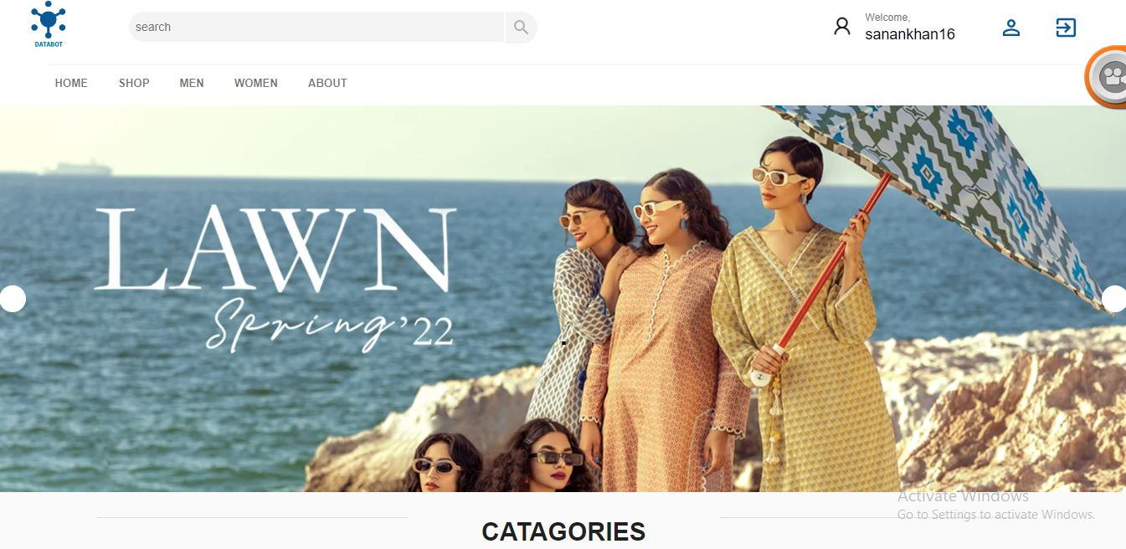
DESIGN (screens)
10
Notes:
10

Slide 11
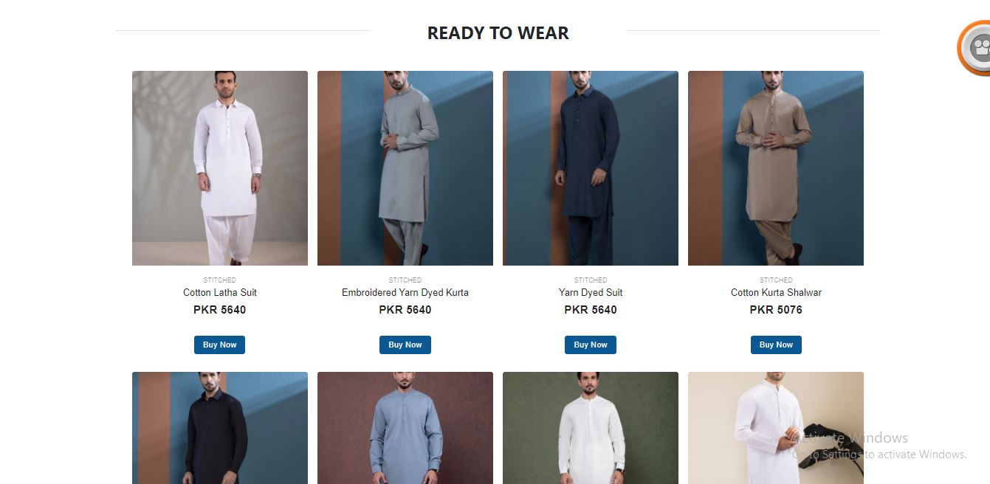
DESIGN (screens)
11
Notes:
11

Slide 12
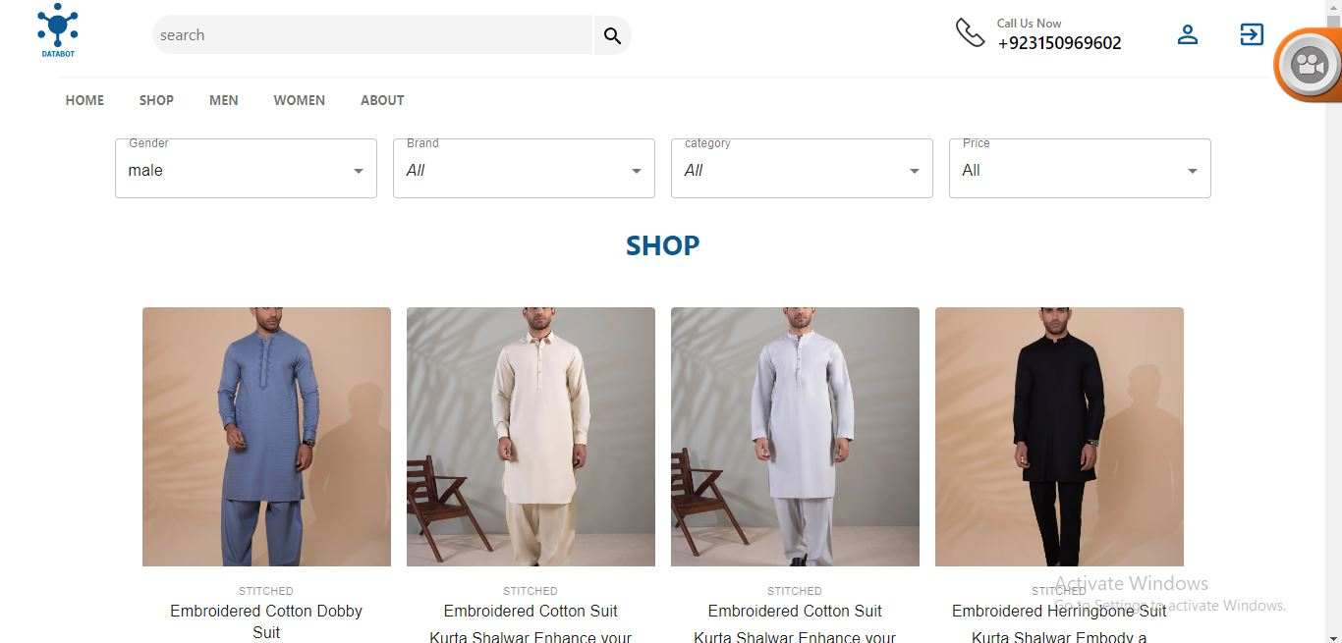
DESIGN (screens)
12
Notes:
12

Slide 13
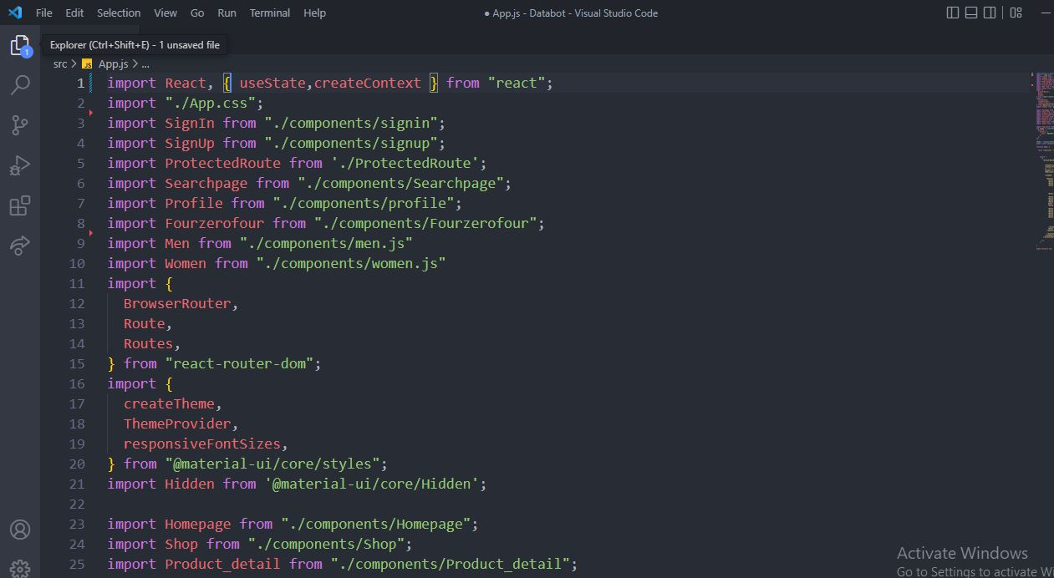
CODING
13
Notes:
13

Slide 14
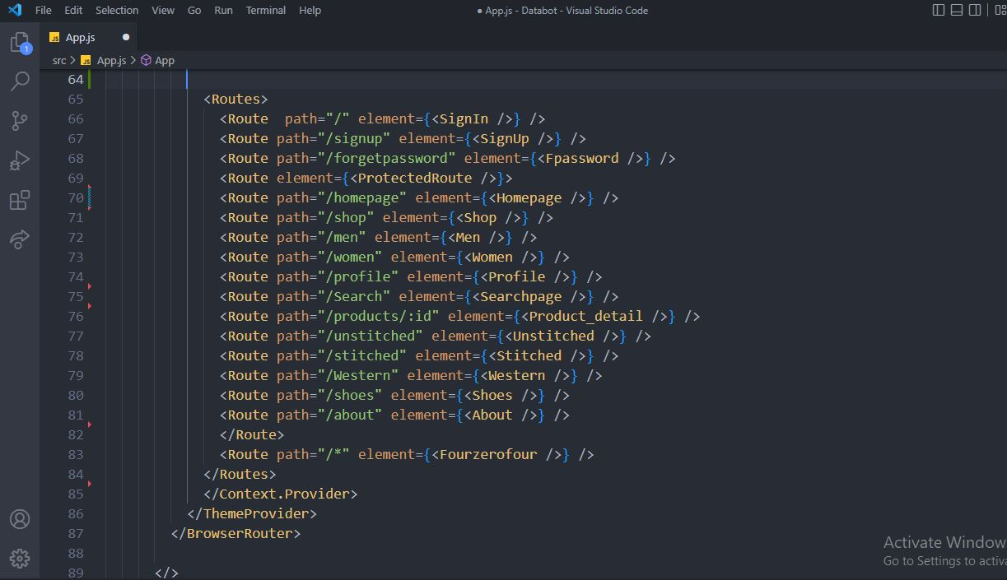
CODING
14
Notes:
14

Slide 15
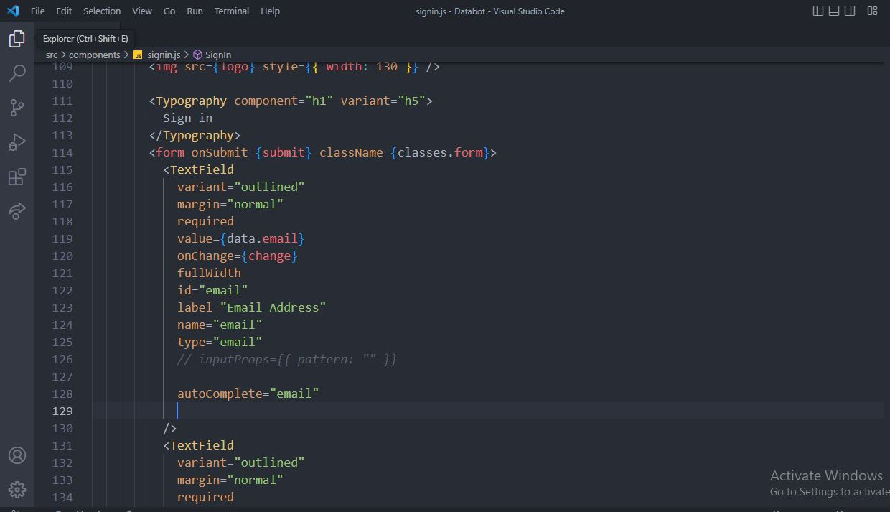
CODING
15
Notes:
15

Slide 16
TESTING
Performance Testing
According PageSpeed Insights application performance score is 97/100.
Security Testing
The application is protected from following vulnerability .
URL Manipulation.
DDoS Attack.
XSS (Cross-Site Scripting).
16
Notes:
16

Slide 17
TESTING
Compatibility testing
Compatibility of application is one of the most crucial things. We have considered while testing the application. During compatibility testing we have checked our application on different Browser and different versions of android operating system.
Usability testing
We done the usability testing to checks the important aspects like proper navigation and responsiveness.
17
Notes:
17

Slide 18
DEPLOYMENT AND FUTURE EXTENSIONS
Deployment
Netlify (Frontend)
Heroku (Backend)
Mongo Atlas (Database)
Future extensions
Add more fashion brands and products.
Enable google ads.
Deploy to Play Store.
Develop IOS application.
18
Notes:
18

Slide 19
REFERENCES
[1] farfetch. (2022). Farfetch. Retrieved February 20, 2022, from https://www.farfetch.com/al/shopping/men/items.aspx
[2] zasimo. (2020). Zasimo. Retrieved March 14, 2022, from
https://zasimo.pk
[3] lyst. (2019). Lyst. Retrieved March 12, 2022, from
https://www.lyst.com
19
Notes:
19

Slide 20
Thank You
20

